Slide 1
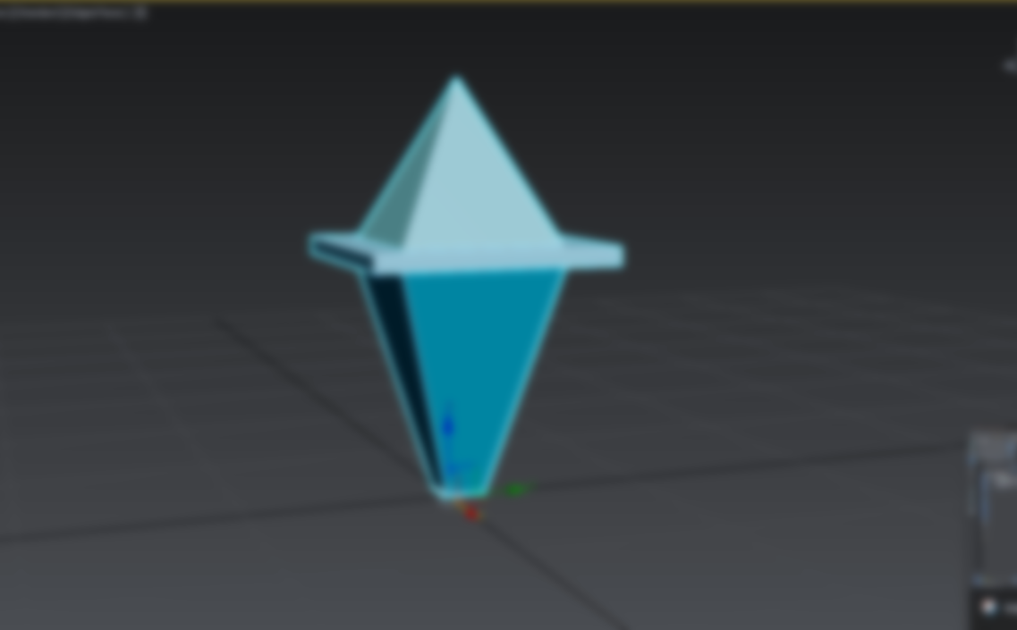
GDV5002 PORT1
St20267371 – hope axford-dando

Slide 2
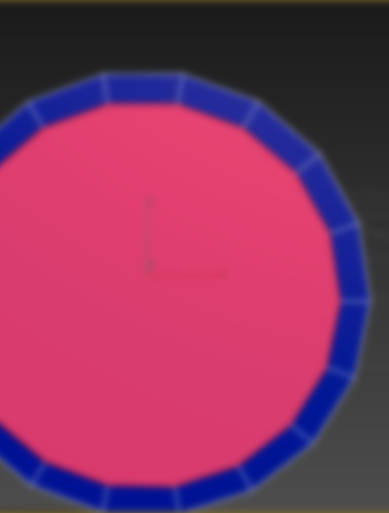
Table of Contents
3D Modelling Slide 3-11
Textures (& animation) Slide 12-14
Level Design Slide 15
Audio Slide 16

Slide 3
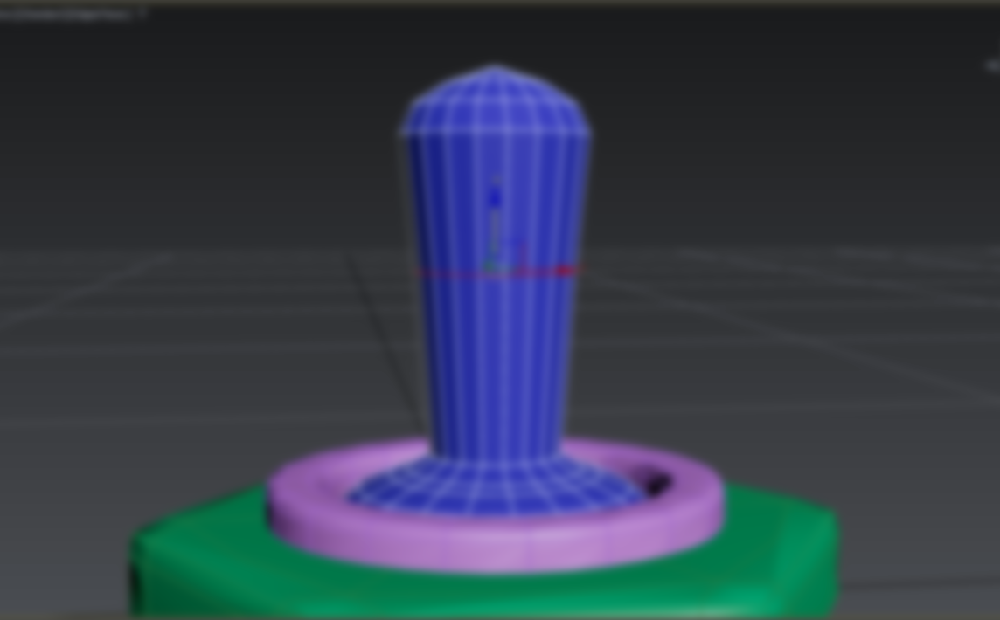
3D Modelling
3ds max 2025

Slide 4
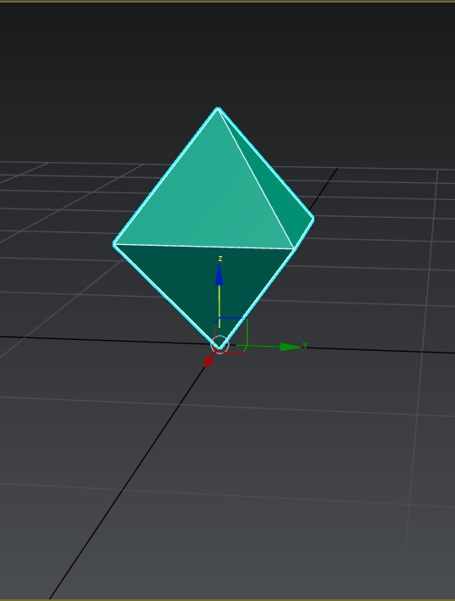
3d modelling: 3ds Max
For 3D modelling, 3Ds Max was used because the software is user-friendly and has industry-standard capabilities. It provides a diverse range of modelling shapes and tools that enable the efficient creation of simple and complex assets. Key features include a real-time rendering system, a robust modifier list for enhancing models, and support for creating high-quality assets, with the help of optimisation for low-poly creations.
Collectively, these features streamlined the workflow, making it an ideal choice for creating the character and scenery assets for the project.

Slide 5
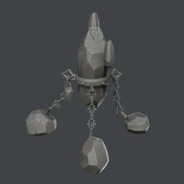
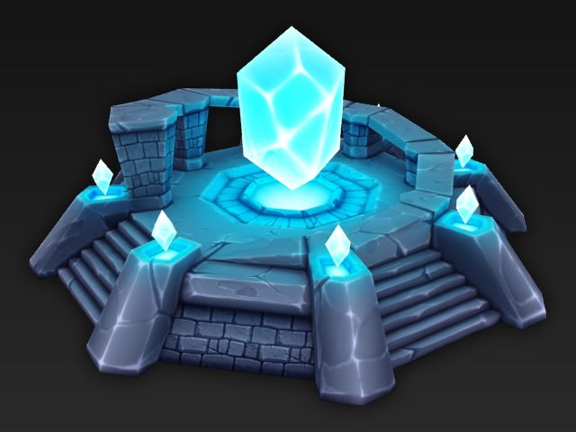
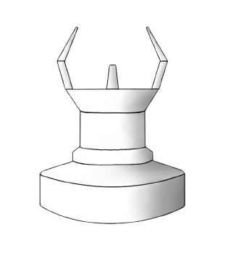
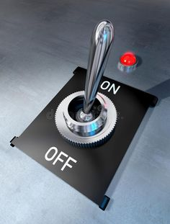
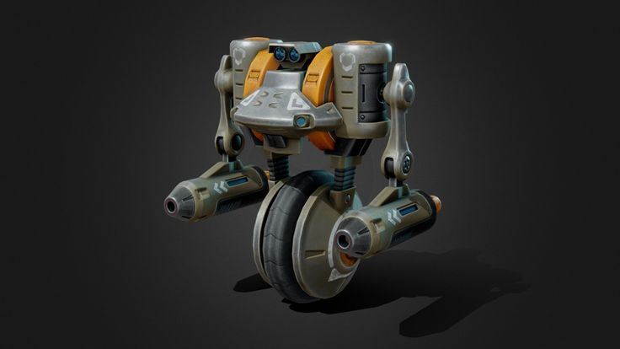
3d Model Concept Art & Inspiration
Figure 2. Inspiration for an energy crystal.
Figure 4. More inspiration for an energy crystal.
Figure 1. Concept art for a laser beacon.
Figure 5. Inspiration for the vehicle character.
Figure 3. Inspiration for a switch.

Slide 6
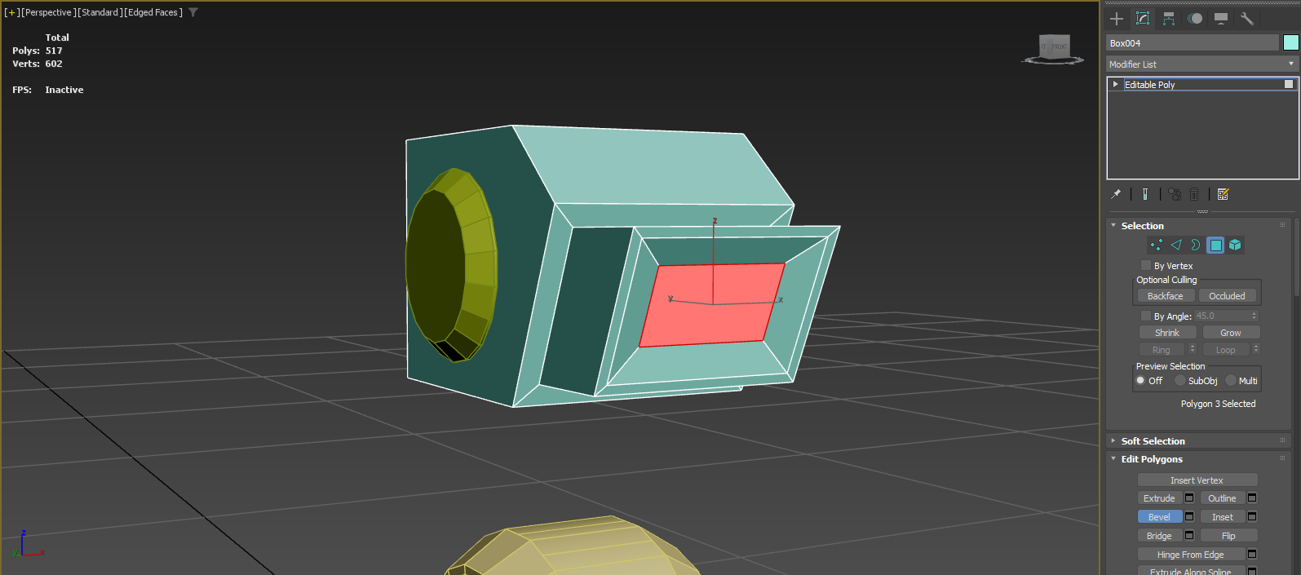
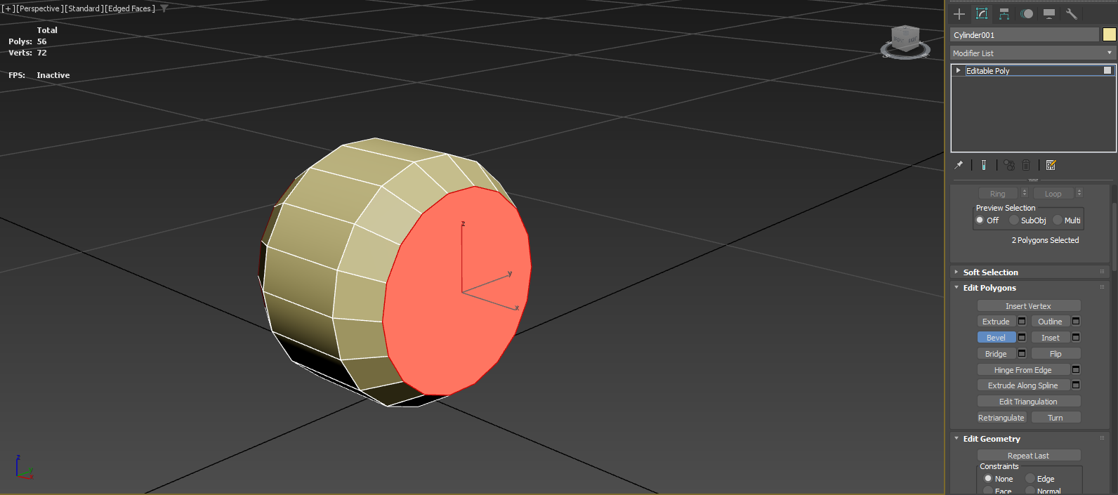
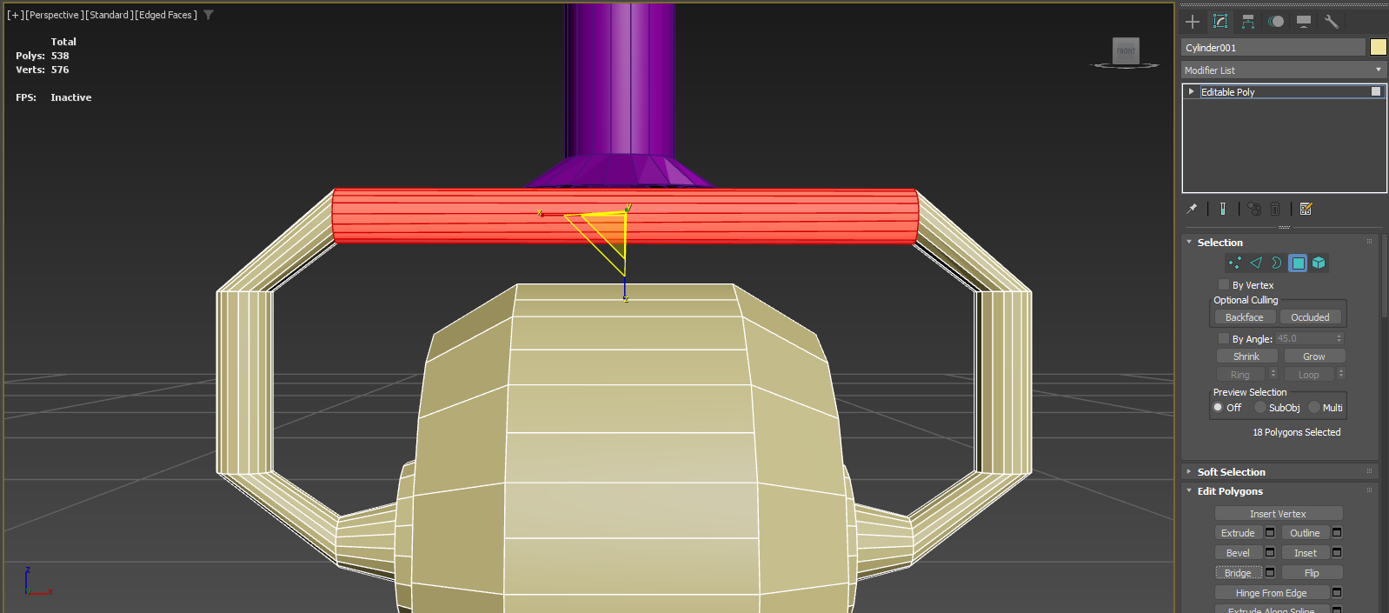
3d Modelling: Character Vehicle
Figure 2. Top of Character Vehicle model.
Figure 1. Beginning of Character Vehicle model.
Figure 3. Tire development for the Character Vehicle model.

Slide 7
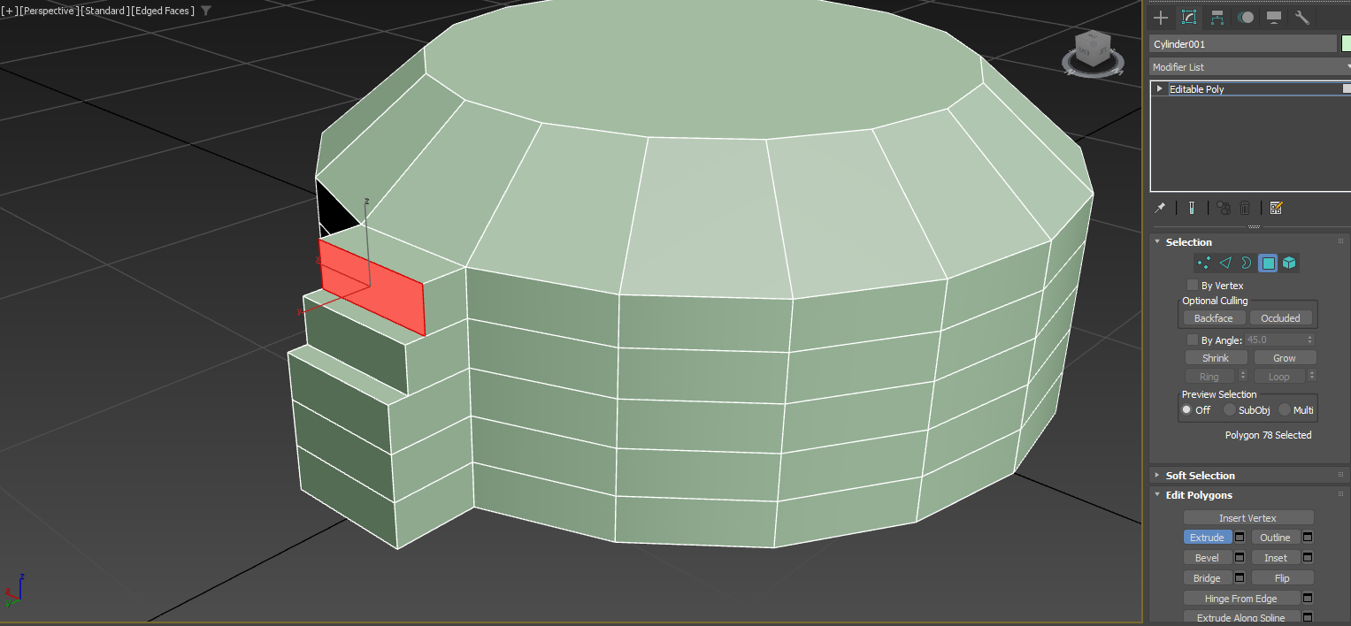
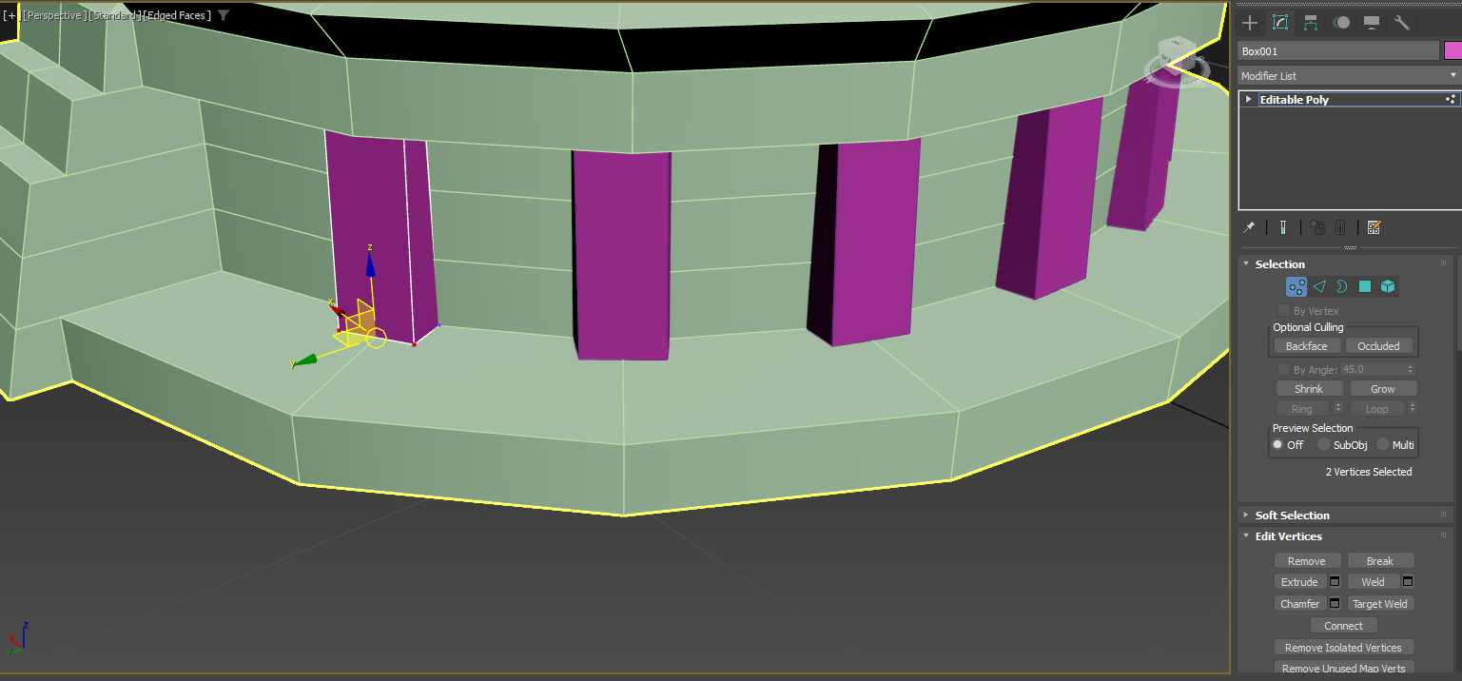
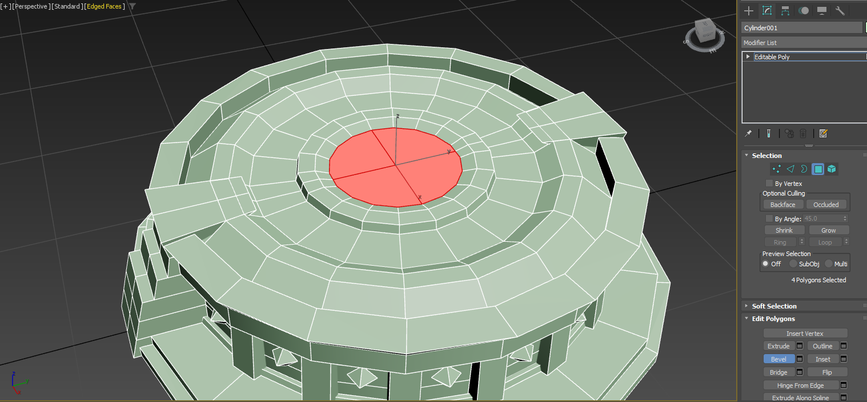
3d Modelling: Energy Crystal
Figure 1. Beginning base for an Energy Crystal model.
Figure 2. Architectural design for an Energy Crystal model.
Figure 3. Complete base for an Energy Crystal model.

Slide 8
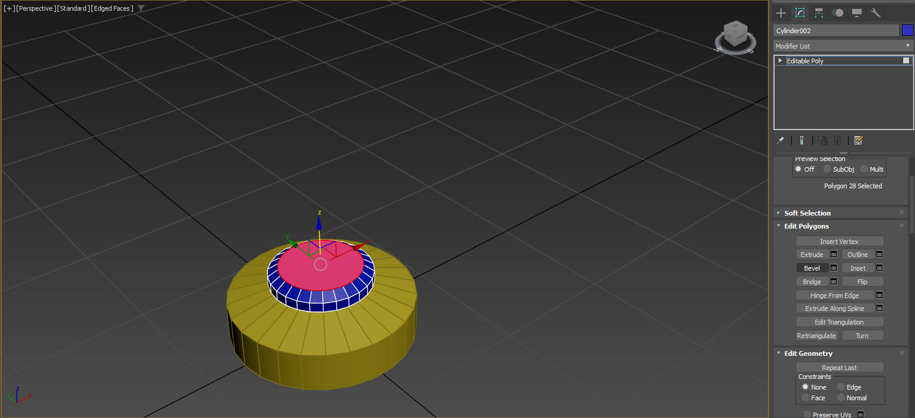
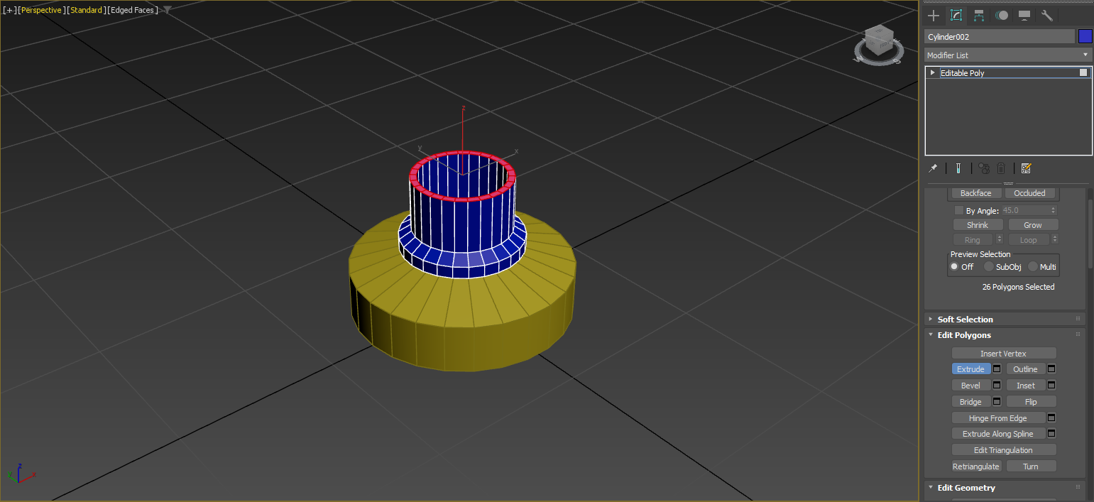
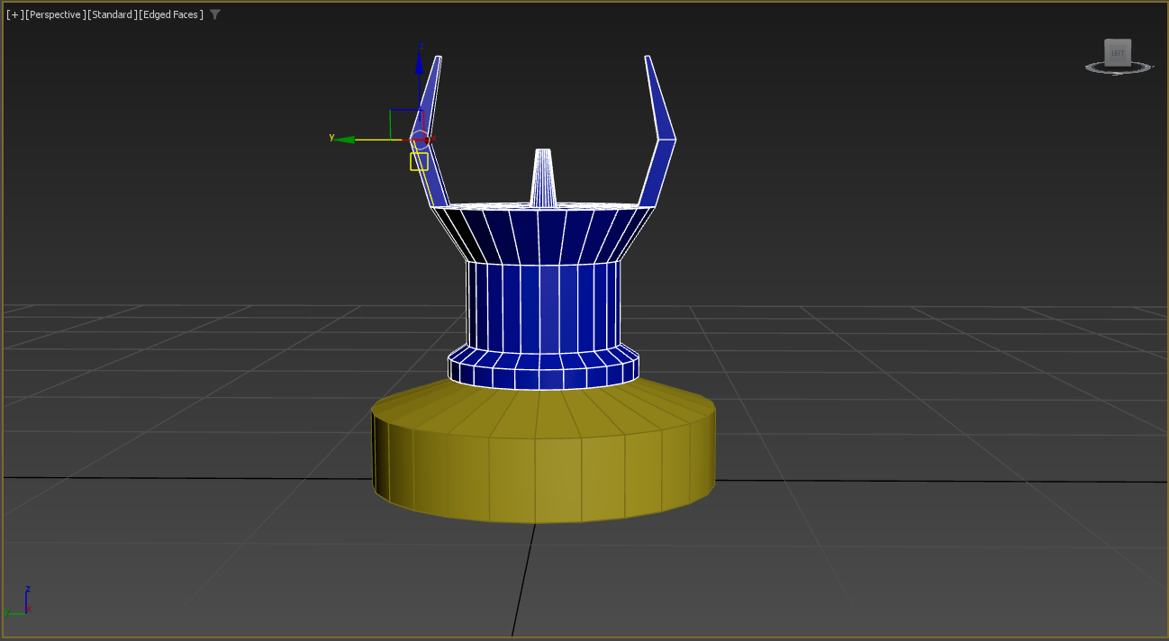
3d Modelling: Laser Beacon
Figure 1. Beginning of a Laser Beacon model.
Figure 2. Middle of a Laser Beacon model.
Figure 3. Top of a Laser Beacon model.

Slide 9
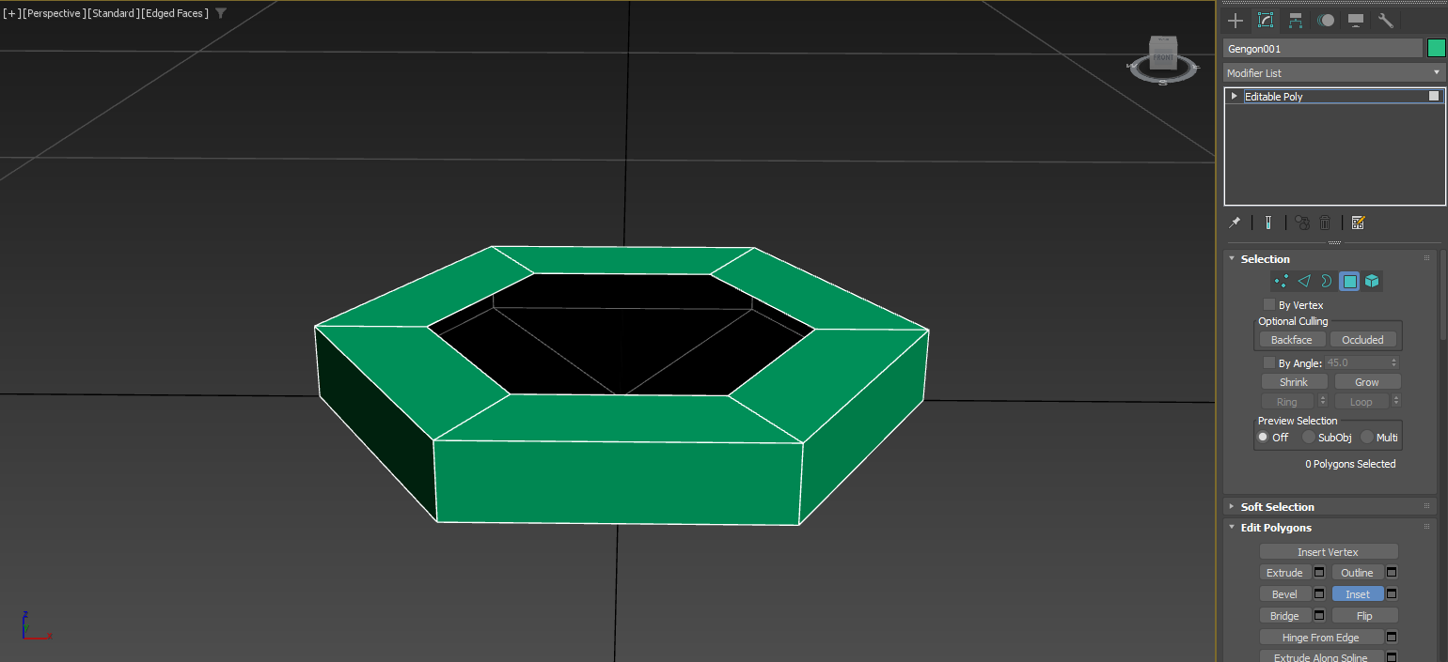
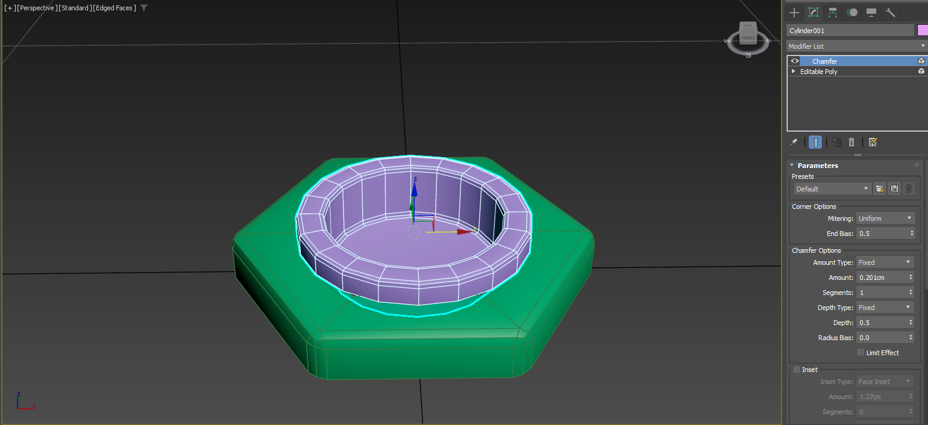
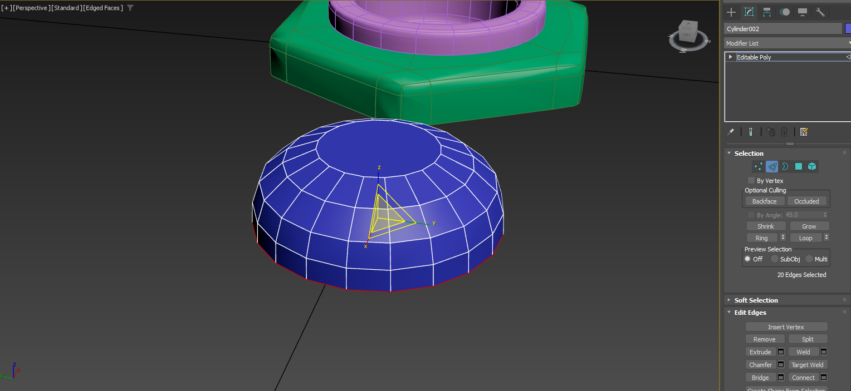
3d Modelling: Switch
Figure 1. Beginning of a Switch model.
Figure 2. Middle of a Switch model.
Figure 3. Base of the Switch for the model.

Slide 10
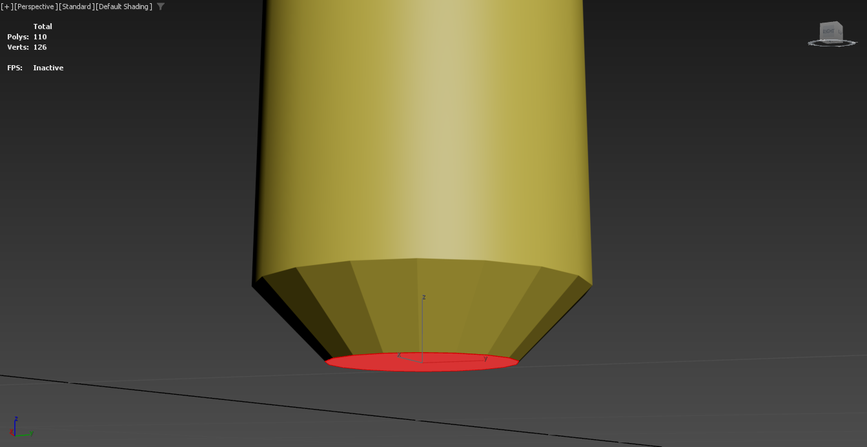
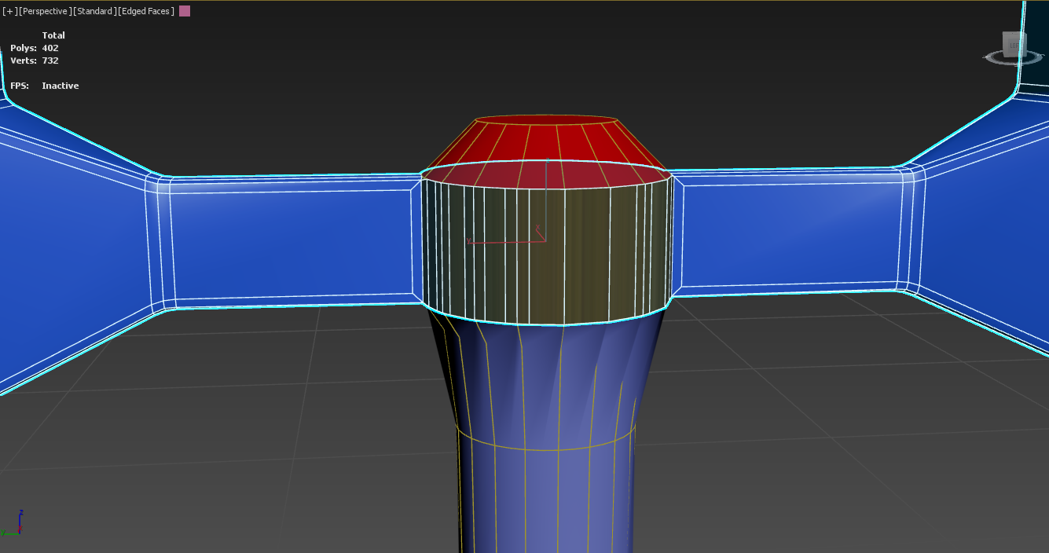
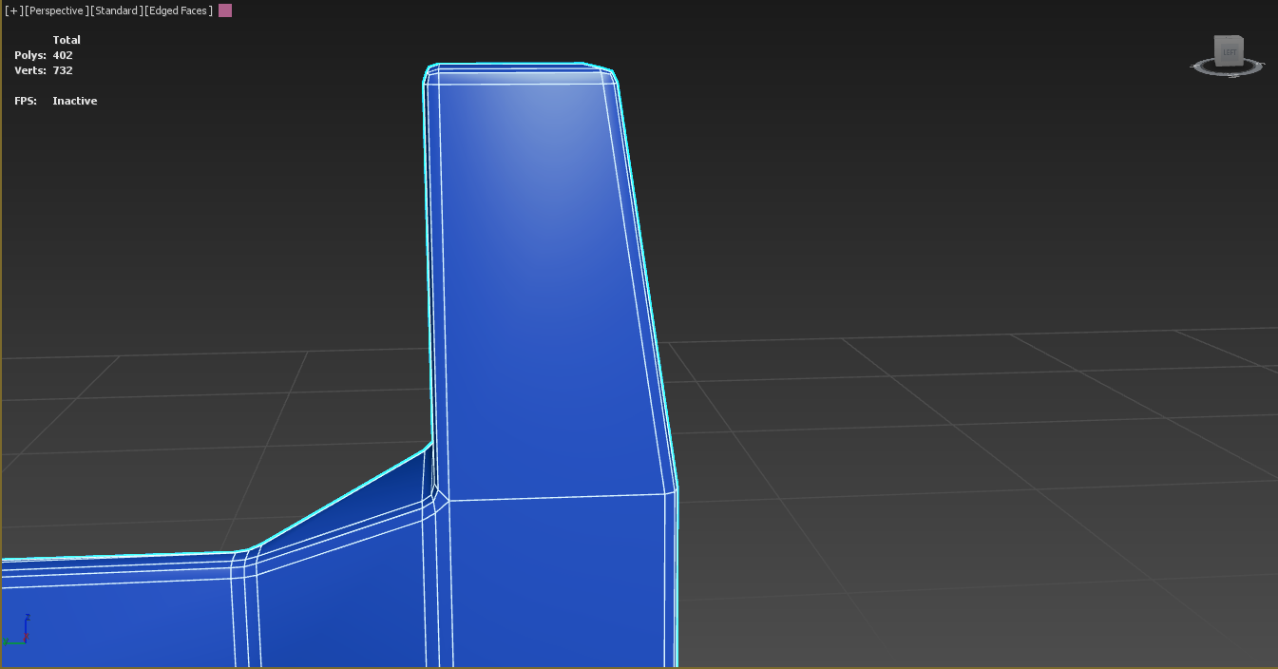
3D Modelling: Scanner
Figure 1. Beginning of a Scanner model.
Figure 2. Moveable arms of a Scanner model.
Figure 3. Arm of a Scanner model.

Slide 11
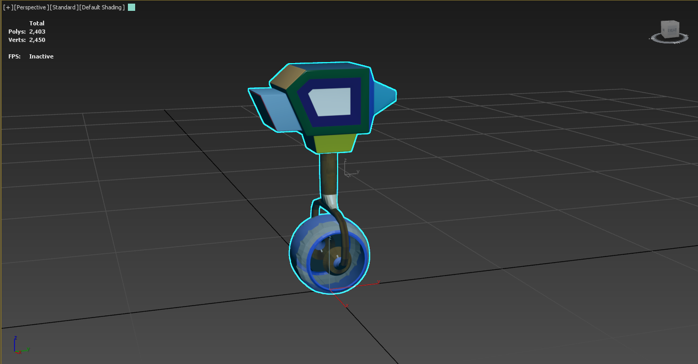
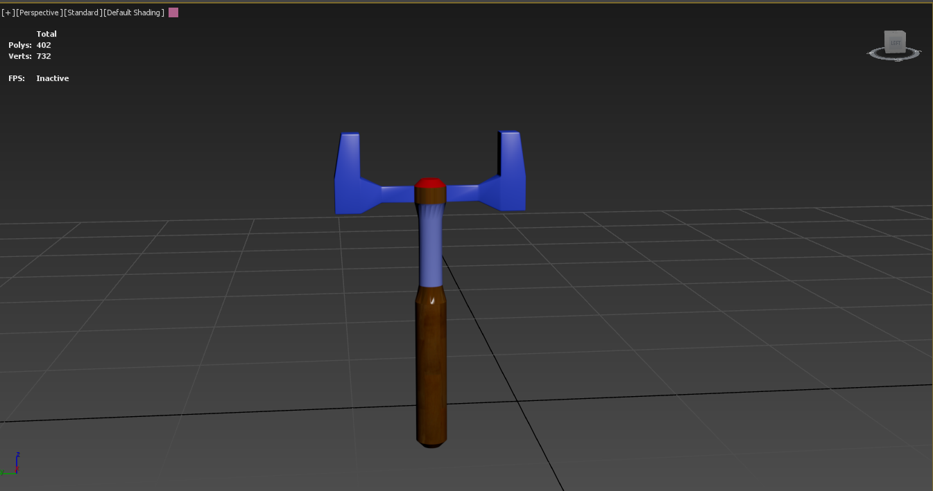
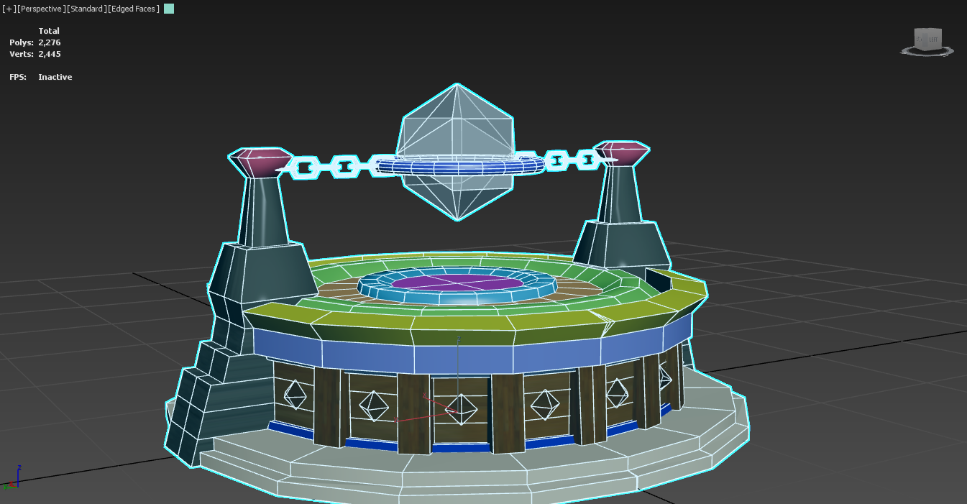
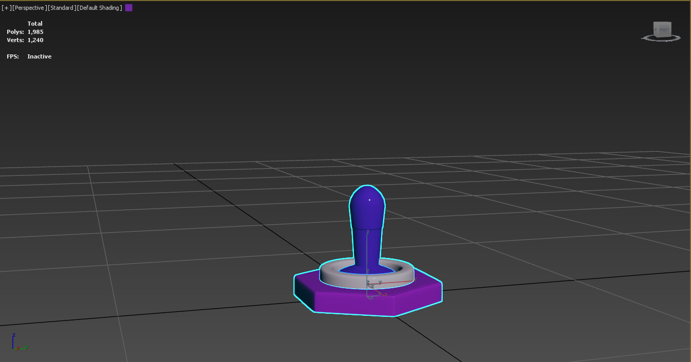
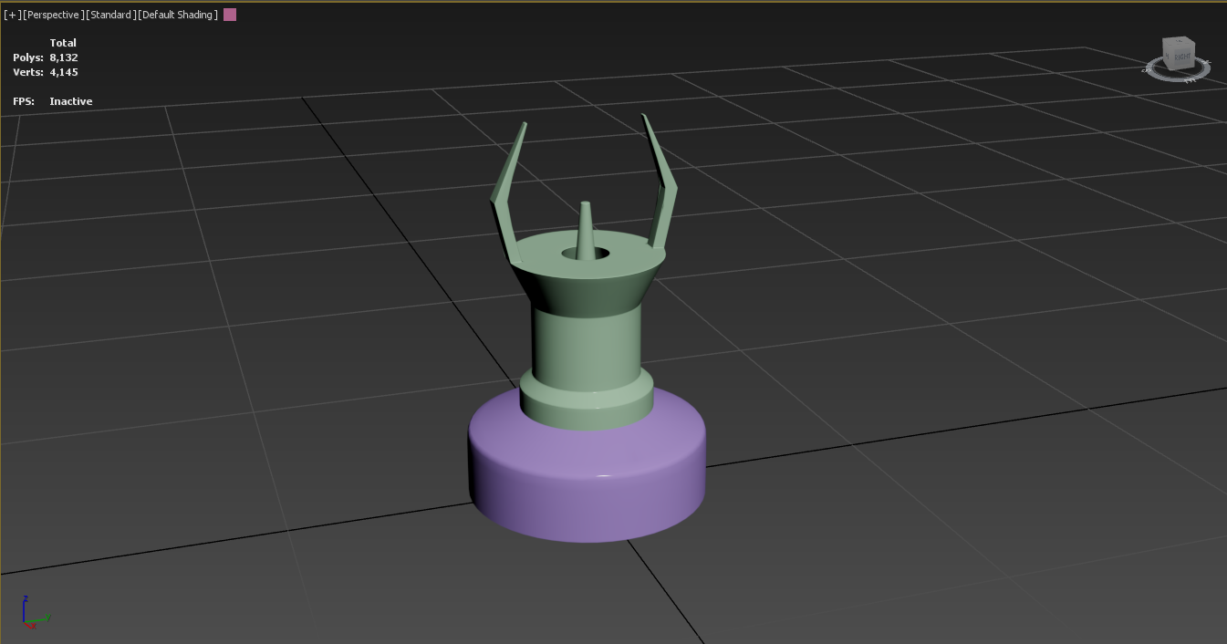
3d Modelling: All Models
Figure 1. Completed Character Vehicle Model.
Figure 4. Completed Scanner Model.
Figure 3. Completed Energy Crystal Model.
Figure 5. Completed Laser Beacon Model.
Figure 2. Completed Switch Model.

Slide 12
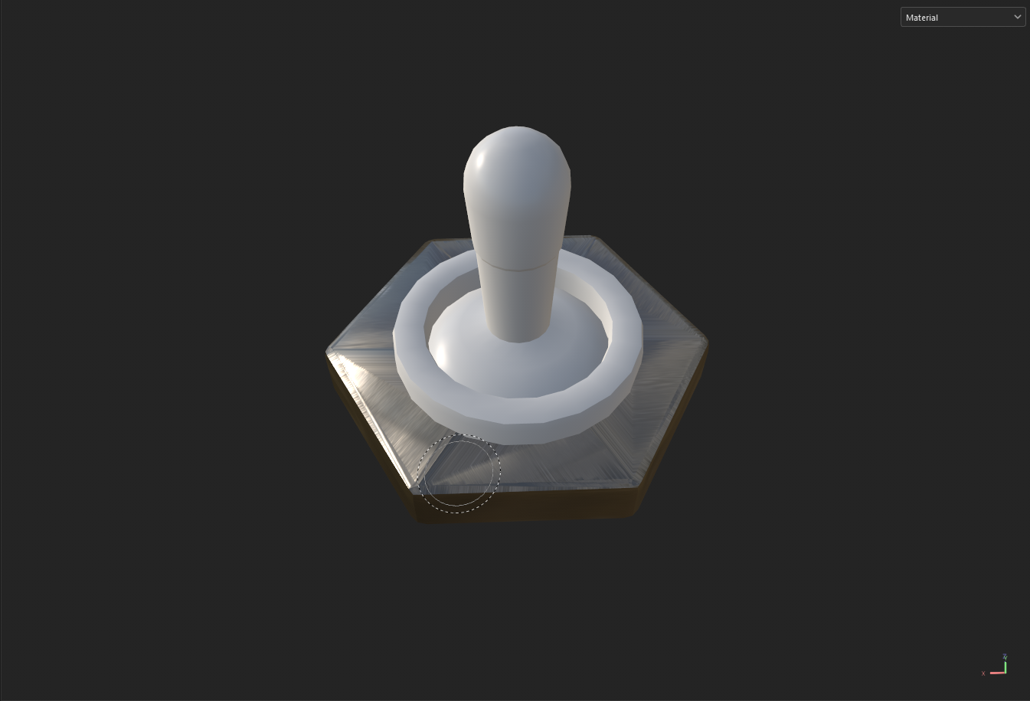
Texturing
ADOBE SUBSTANCE PAINTER

Slide 13
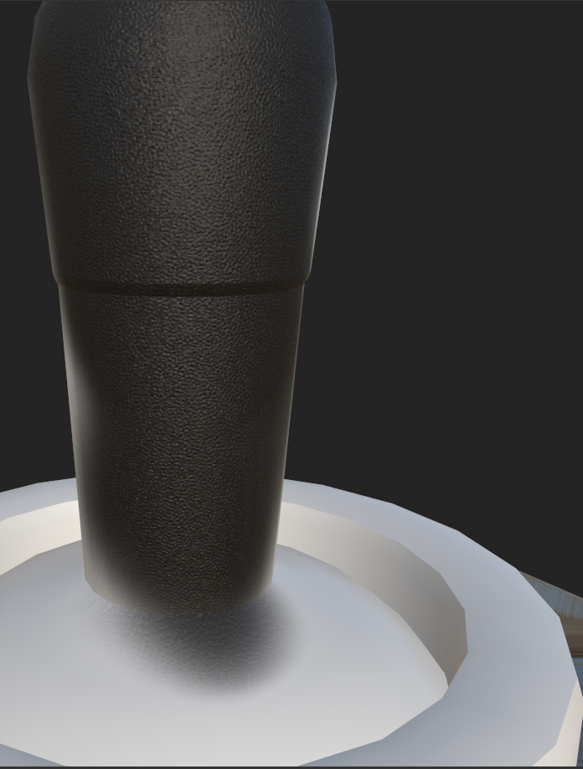
Texturing: Substance Painter
To texture all five of the models, Adobe Substance Painter was used. Rather than UV unwrapping the models and then texturing by painting the UV maps, materials were used to section the models out, and then they were exported from 3Ds Max as .fbx files into Adobe Substance Painter where those models were automatically unwrapped for painting.
The materials applied within 3Ds Max were automatically made into texture sets when imported into Adobe Substance Painter. This was significantly easier than painting directly onto UV maps.

Slide 14
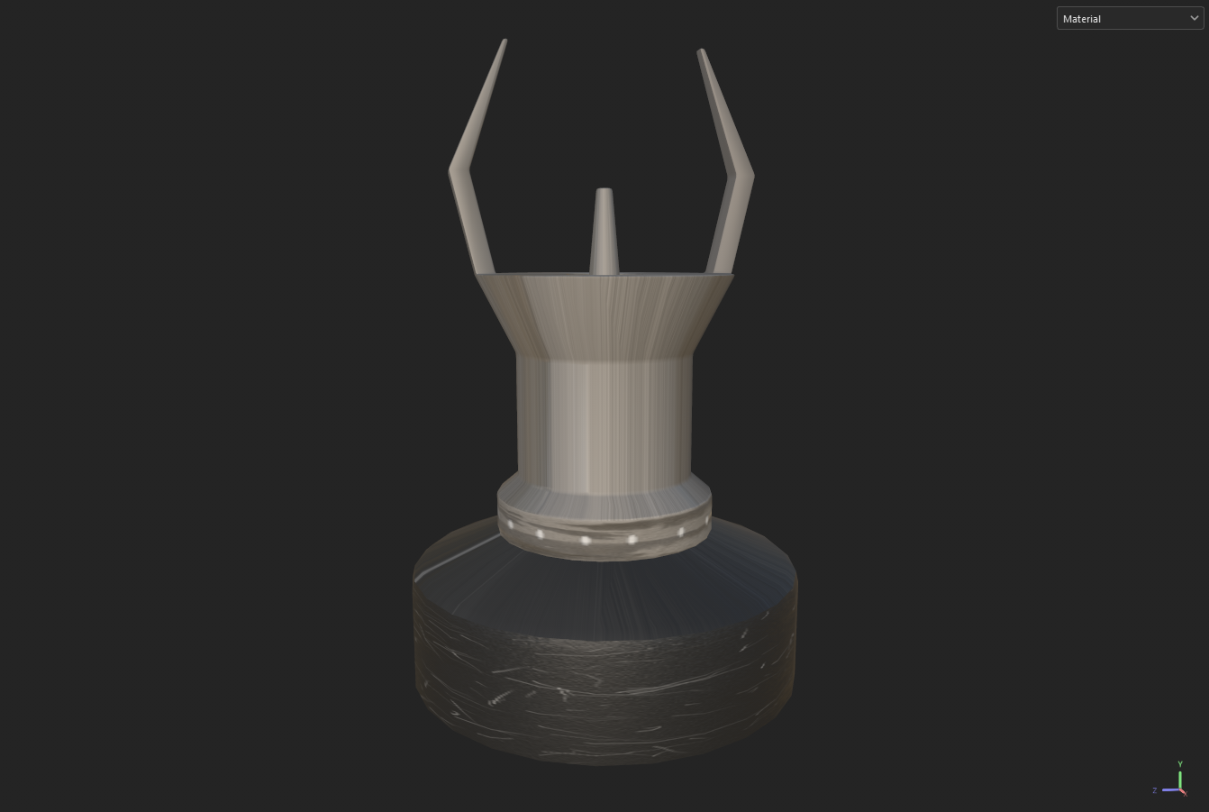
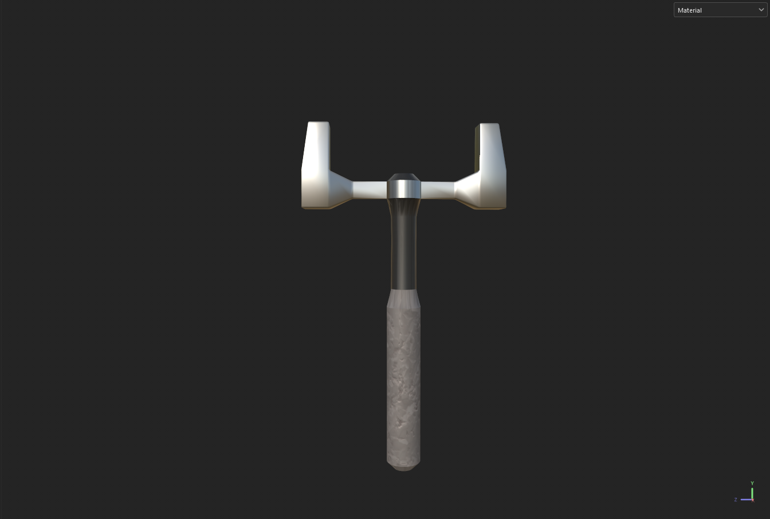
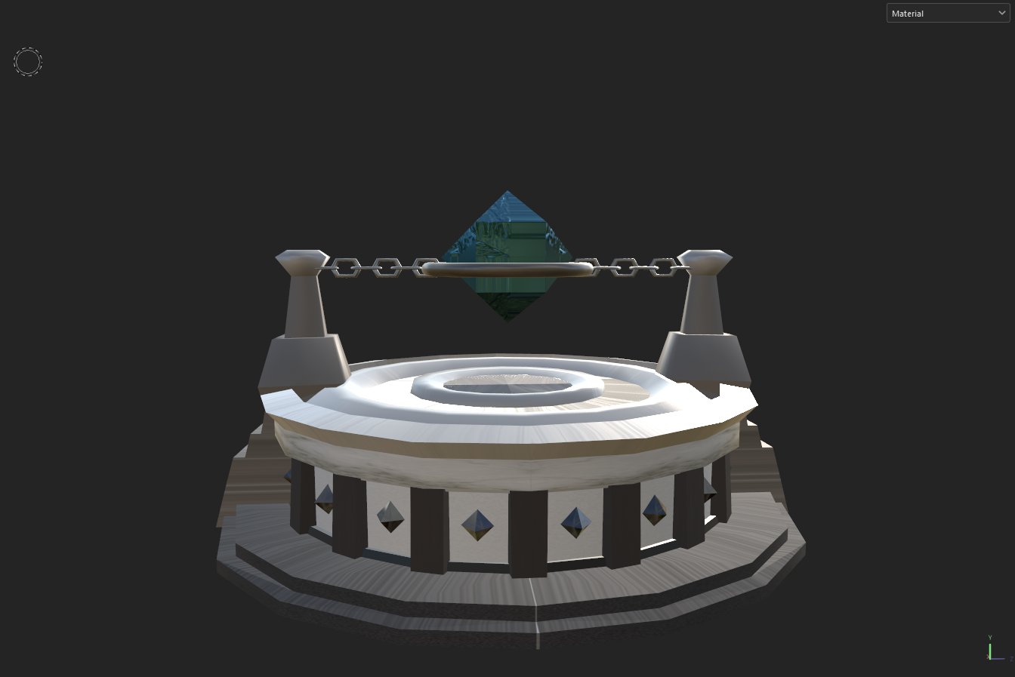
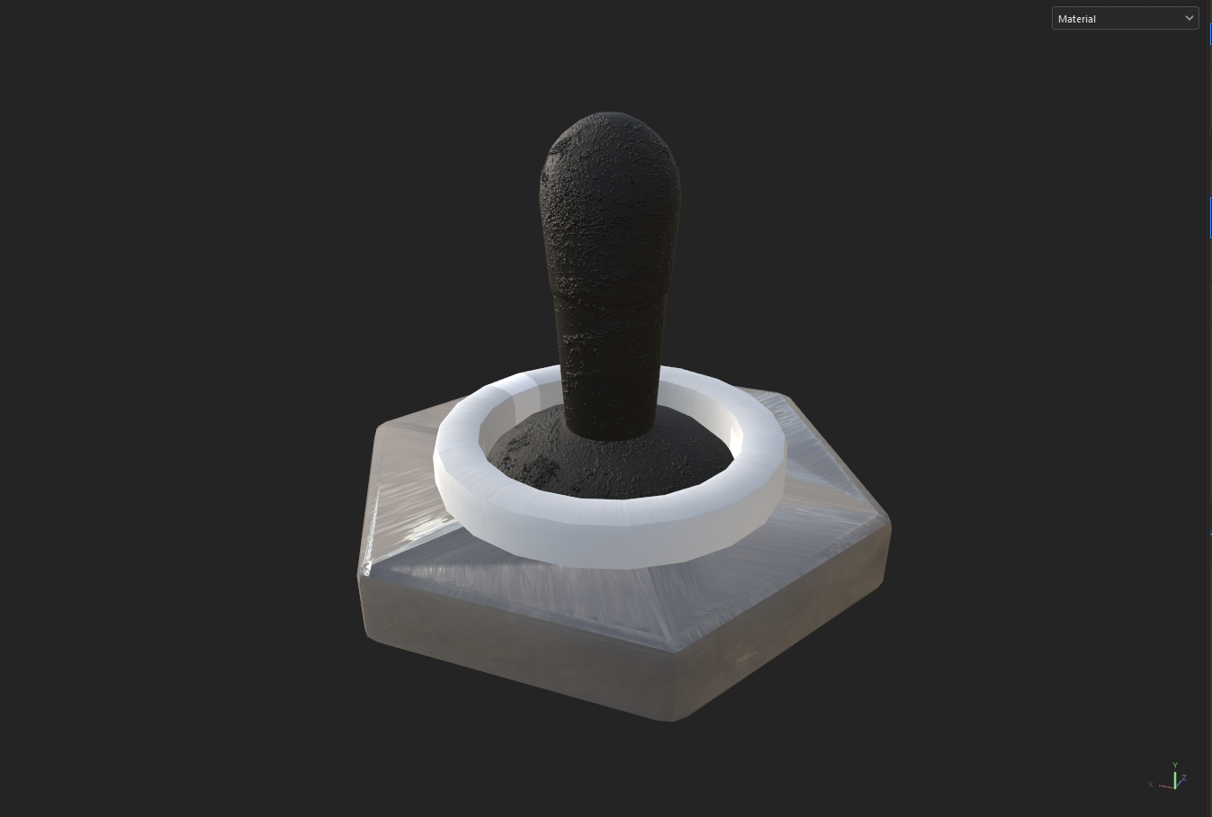
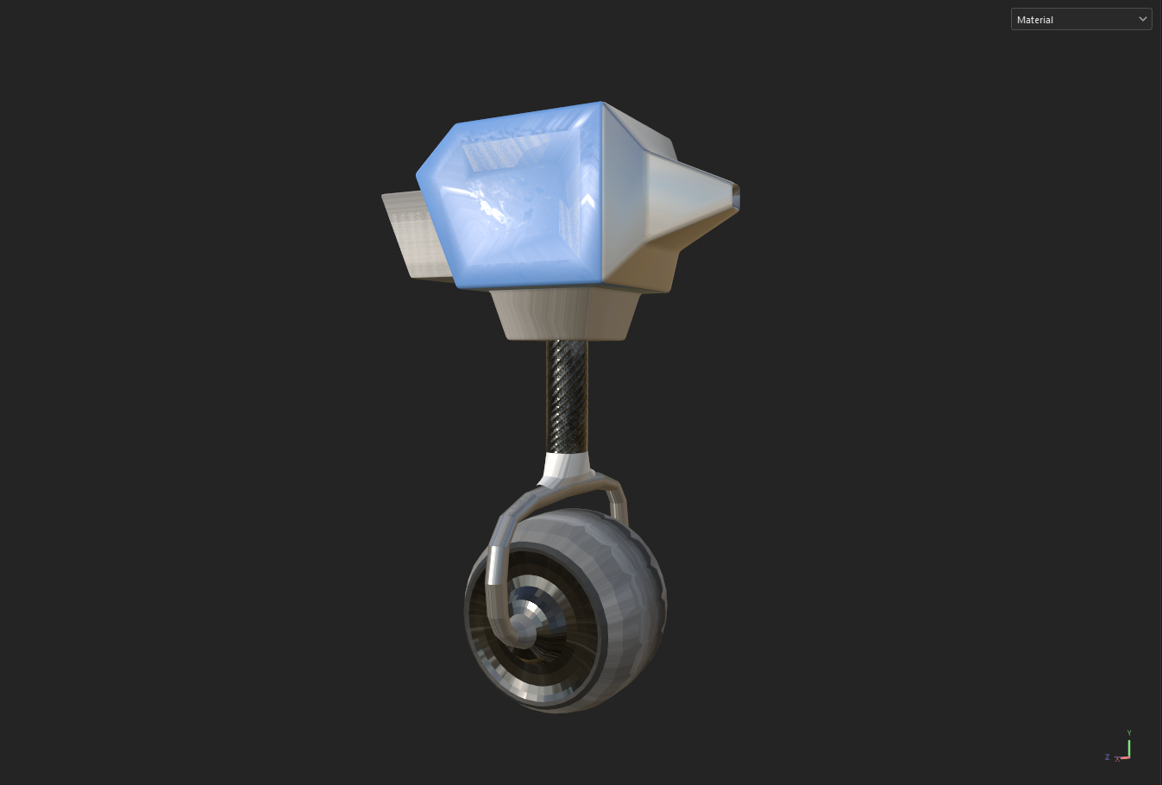
Texturing
Figure 1. Textured Laser Beacon Model.
Figure 4. Textured Scanner Model.
Figure 3. Textured Energy Crystal Model.
Figure 2. Textured Switch Model.
Figure 5. Textured Character Vehicle Model.

Slide 15
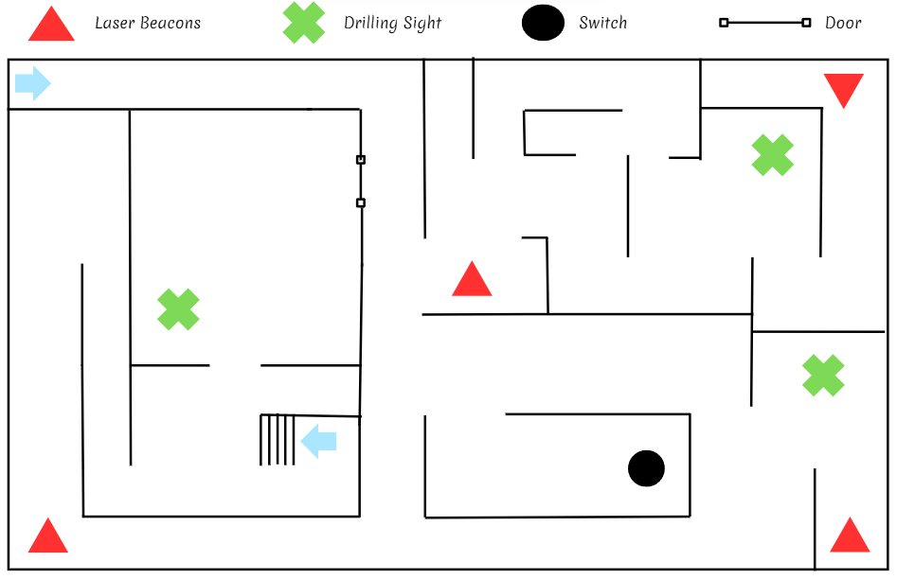
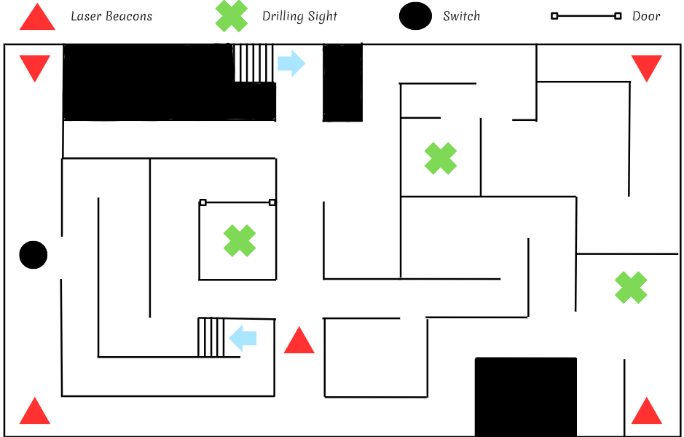
Level Design Concepts
Level 1: More space, easy access to switch
Level 2: Less space, difficult access to switch

Slide 16

Audio
The following links are the audios downloaded from royalty-free sites:

Slide 17
Video Demo Link
https://youtu.be/952f_PndZ08

